Slide 1

Examining the Correlation Between Religion, Voting Patterns, and Anti-LGBT Legislation in the United States
Oliver Reidmiller

Slide 2

Background
The United States has experienced ongoing debates and legislative efforts regarding LGBT rights, especially on transgender individuals. This project aims to investigate the potential correlation between religion, voting patterns, and the introduction of anti-LGBT legislation. This will hopefully give some more insights to the role religion plays in voters morals and how they affect their political decisions.

Slide 3
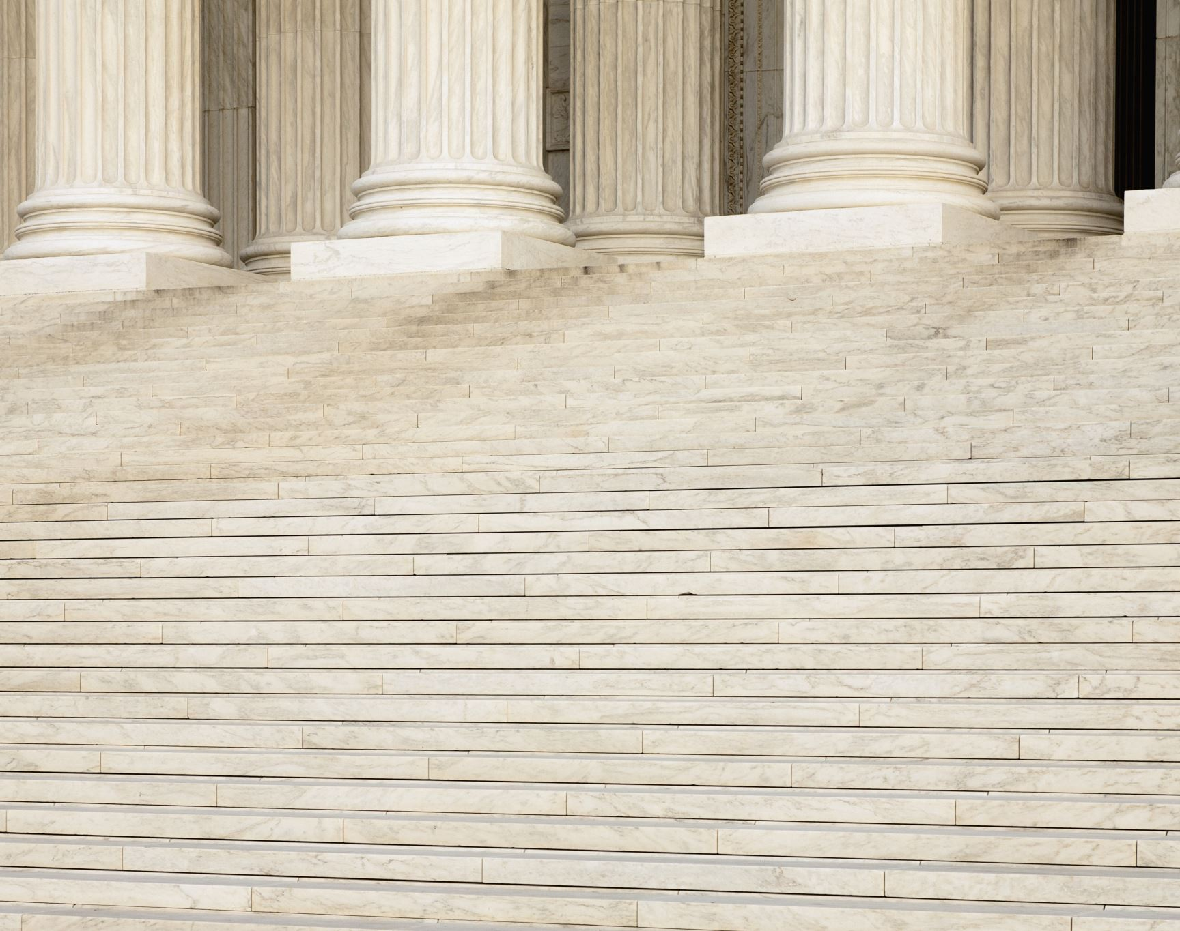
Research Questions
What is the strength and nature of the correlation between religious beliefs in the population and the introduction of anti-LGBT legislation in the United States?
How do voting patterns align with church density and influence legislative outcomes?
Are there regional variations in church density that correspond to distinct legislative trends?

Slide 4

Data Sources
Voting Patterns Data on the 2020 Presidential election from the MIT Election Data + Science Lab
Anti-LGBT+ Legislation Introduced Data from the ACLU Mapping Attacks on LGBTQ Rights in U.S. State Legislatures in 2023
GIS Data on All Places of Worship
2020 US Religious Census

Slide 5
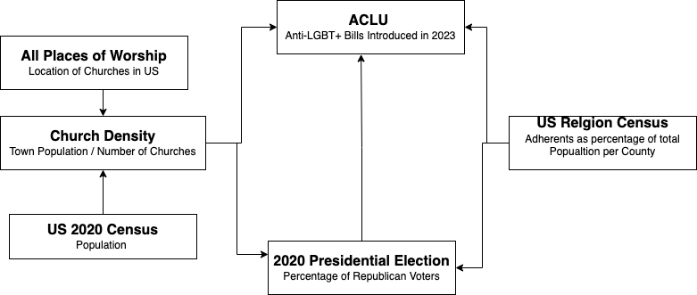
Methods of Analysis

Slide 6
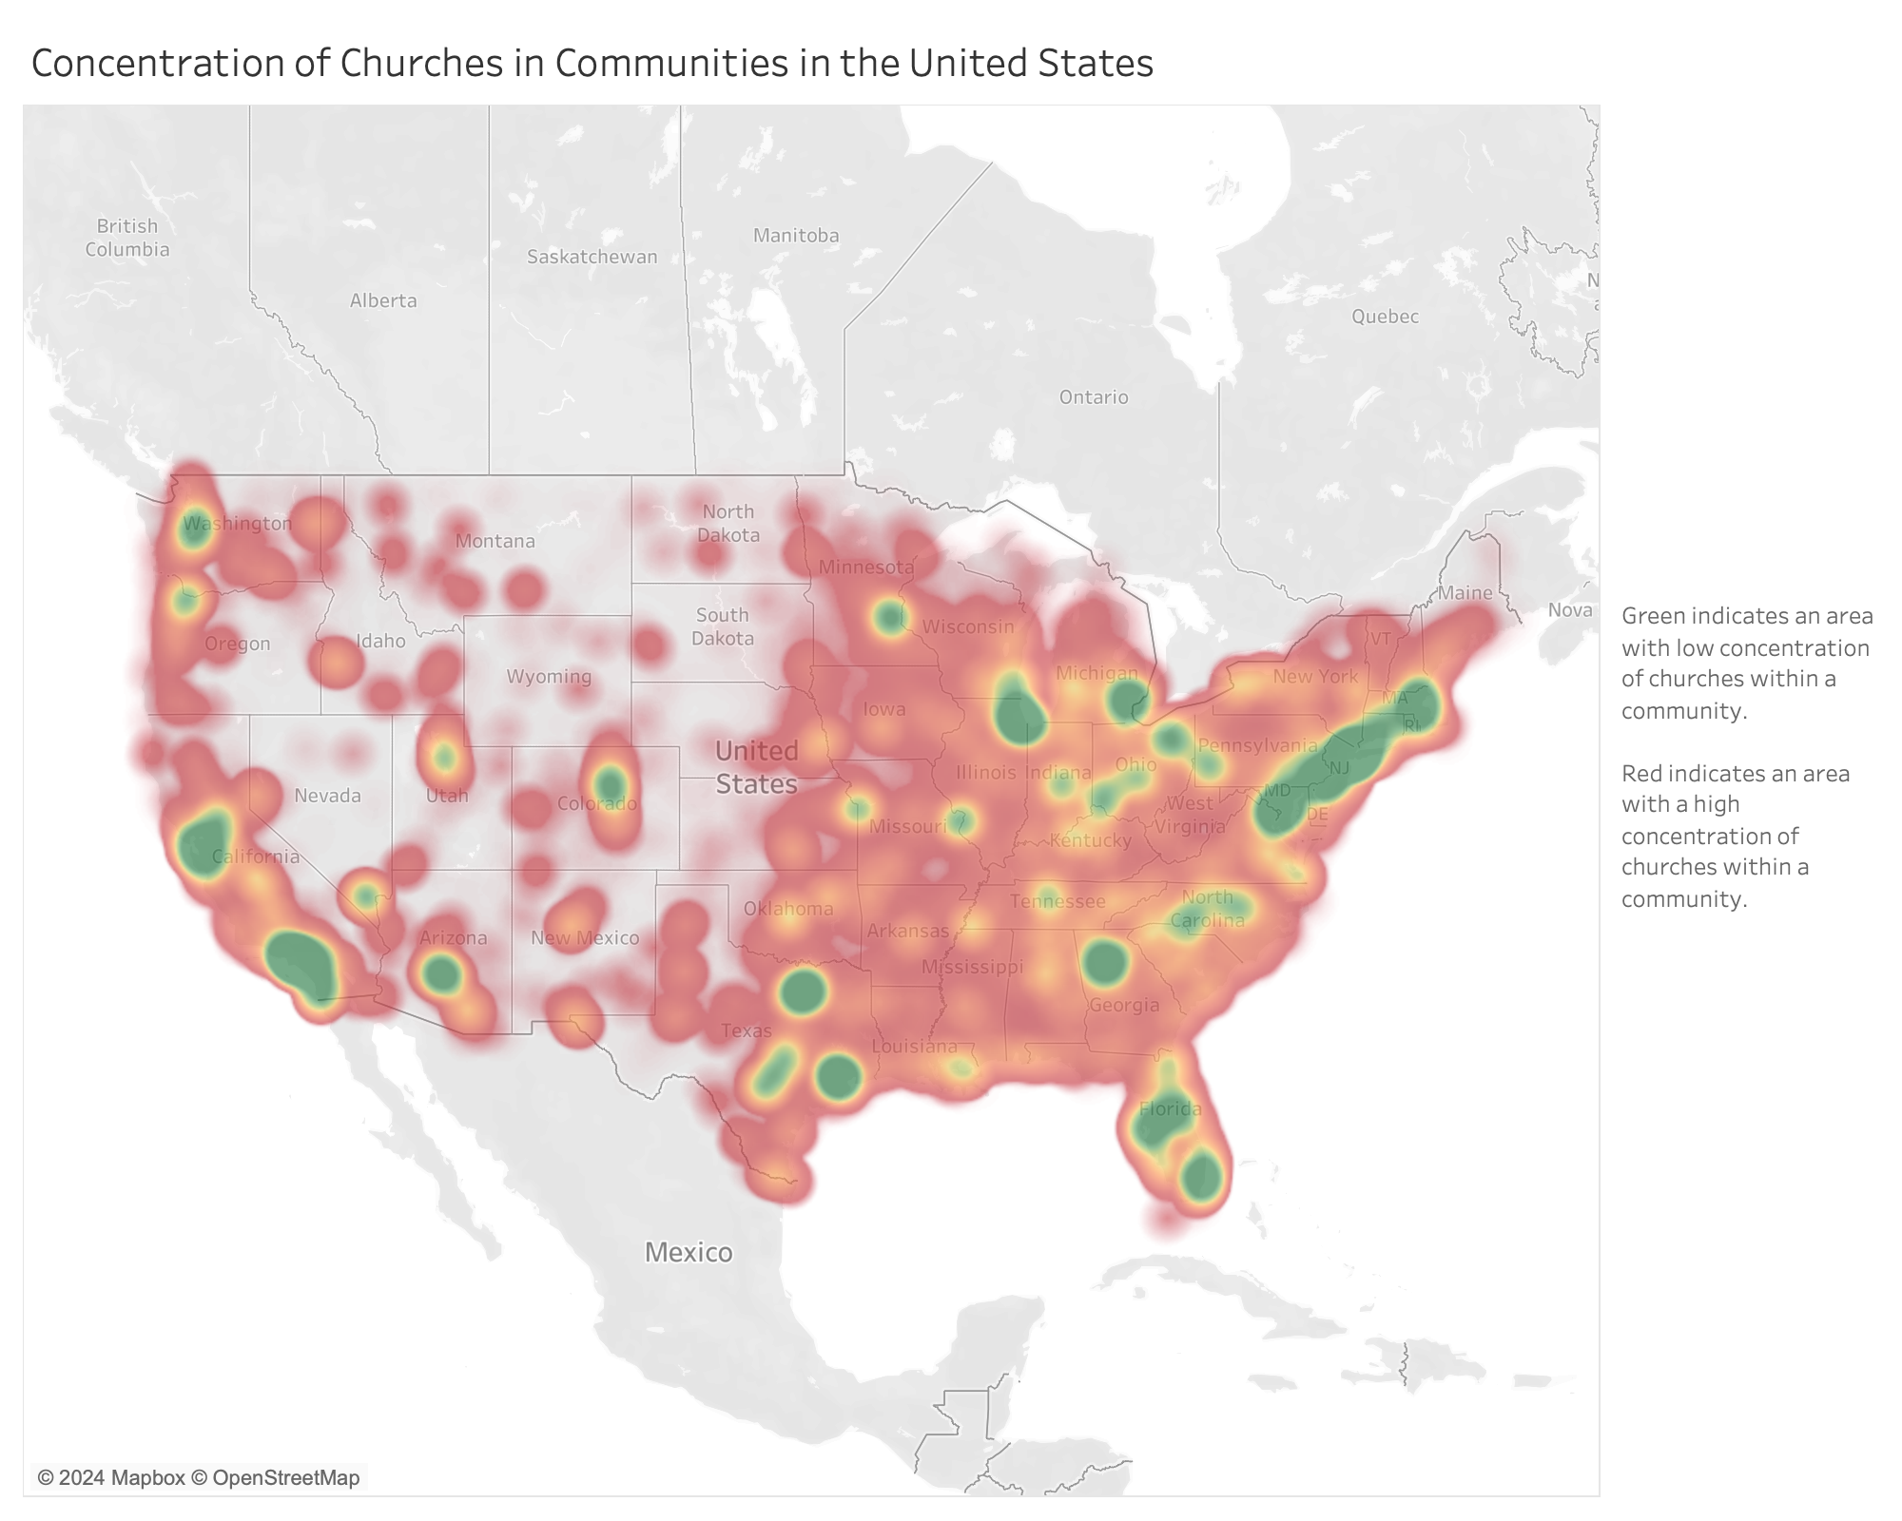
Exploratory Data Analysis: All Places of Worship Data

Slide 7
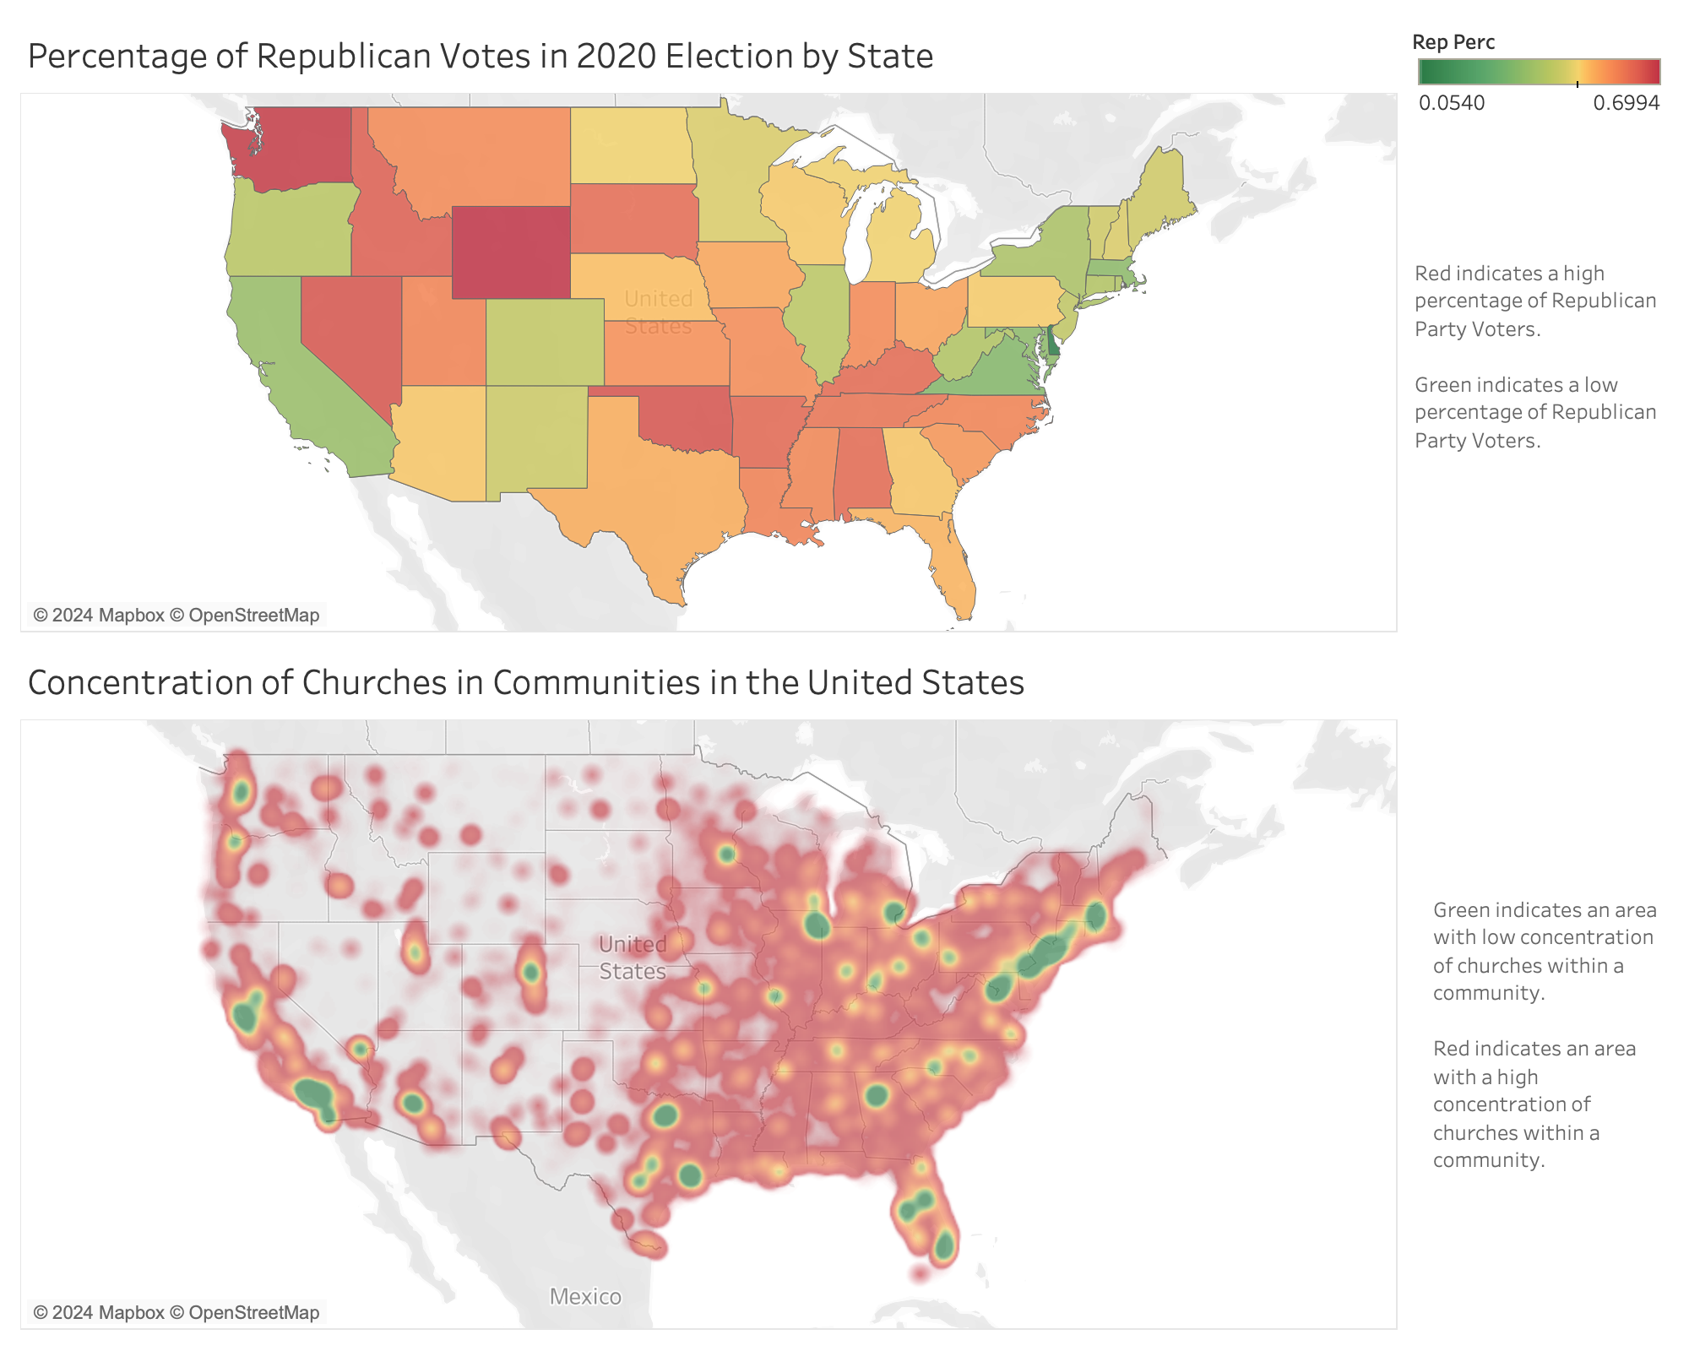

Slide 8
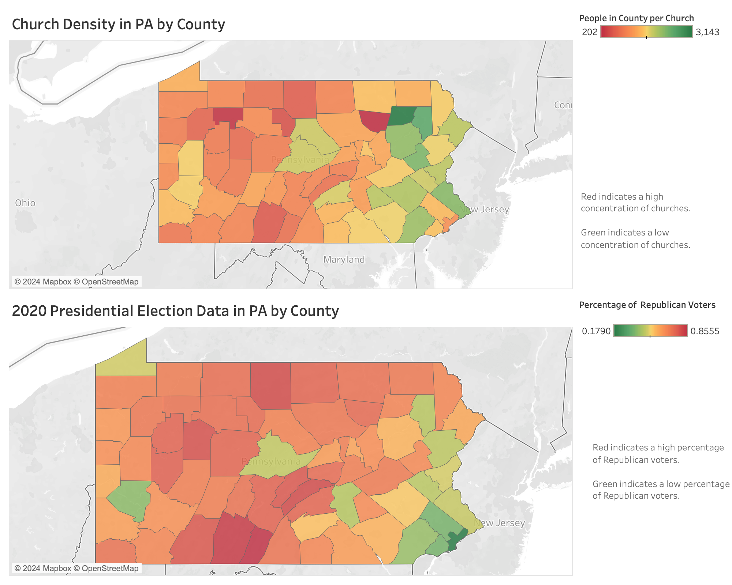

Slide 9
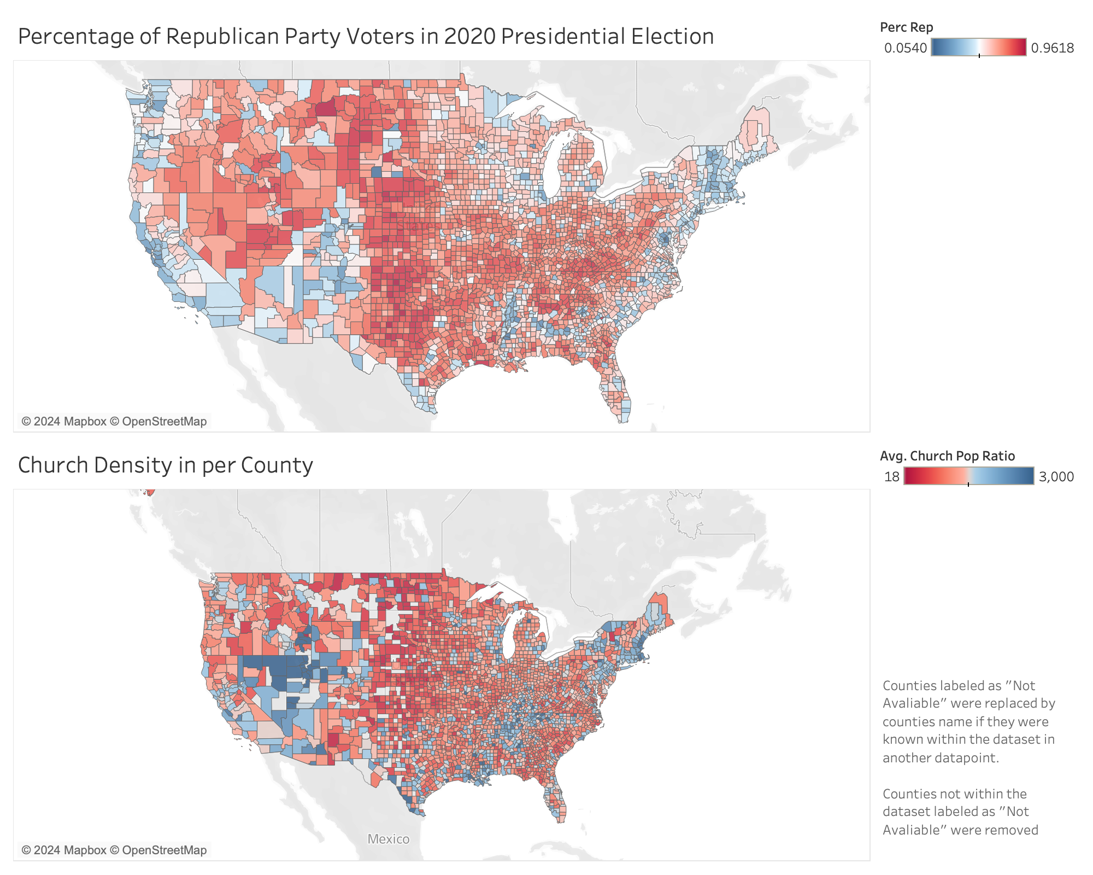
County Level

Slide 10
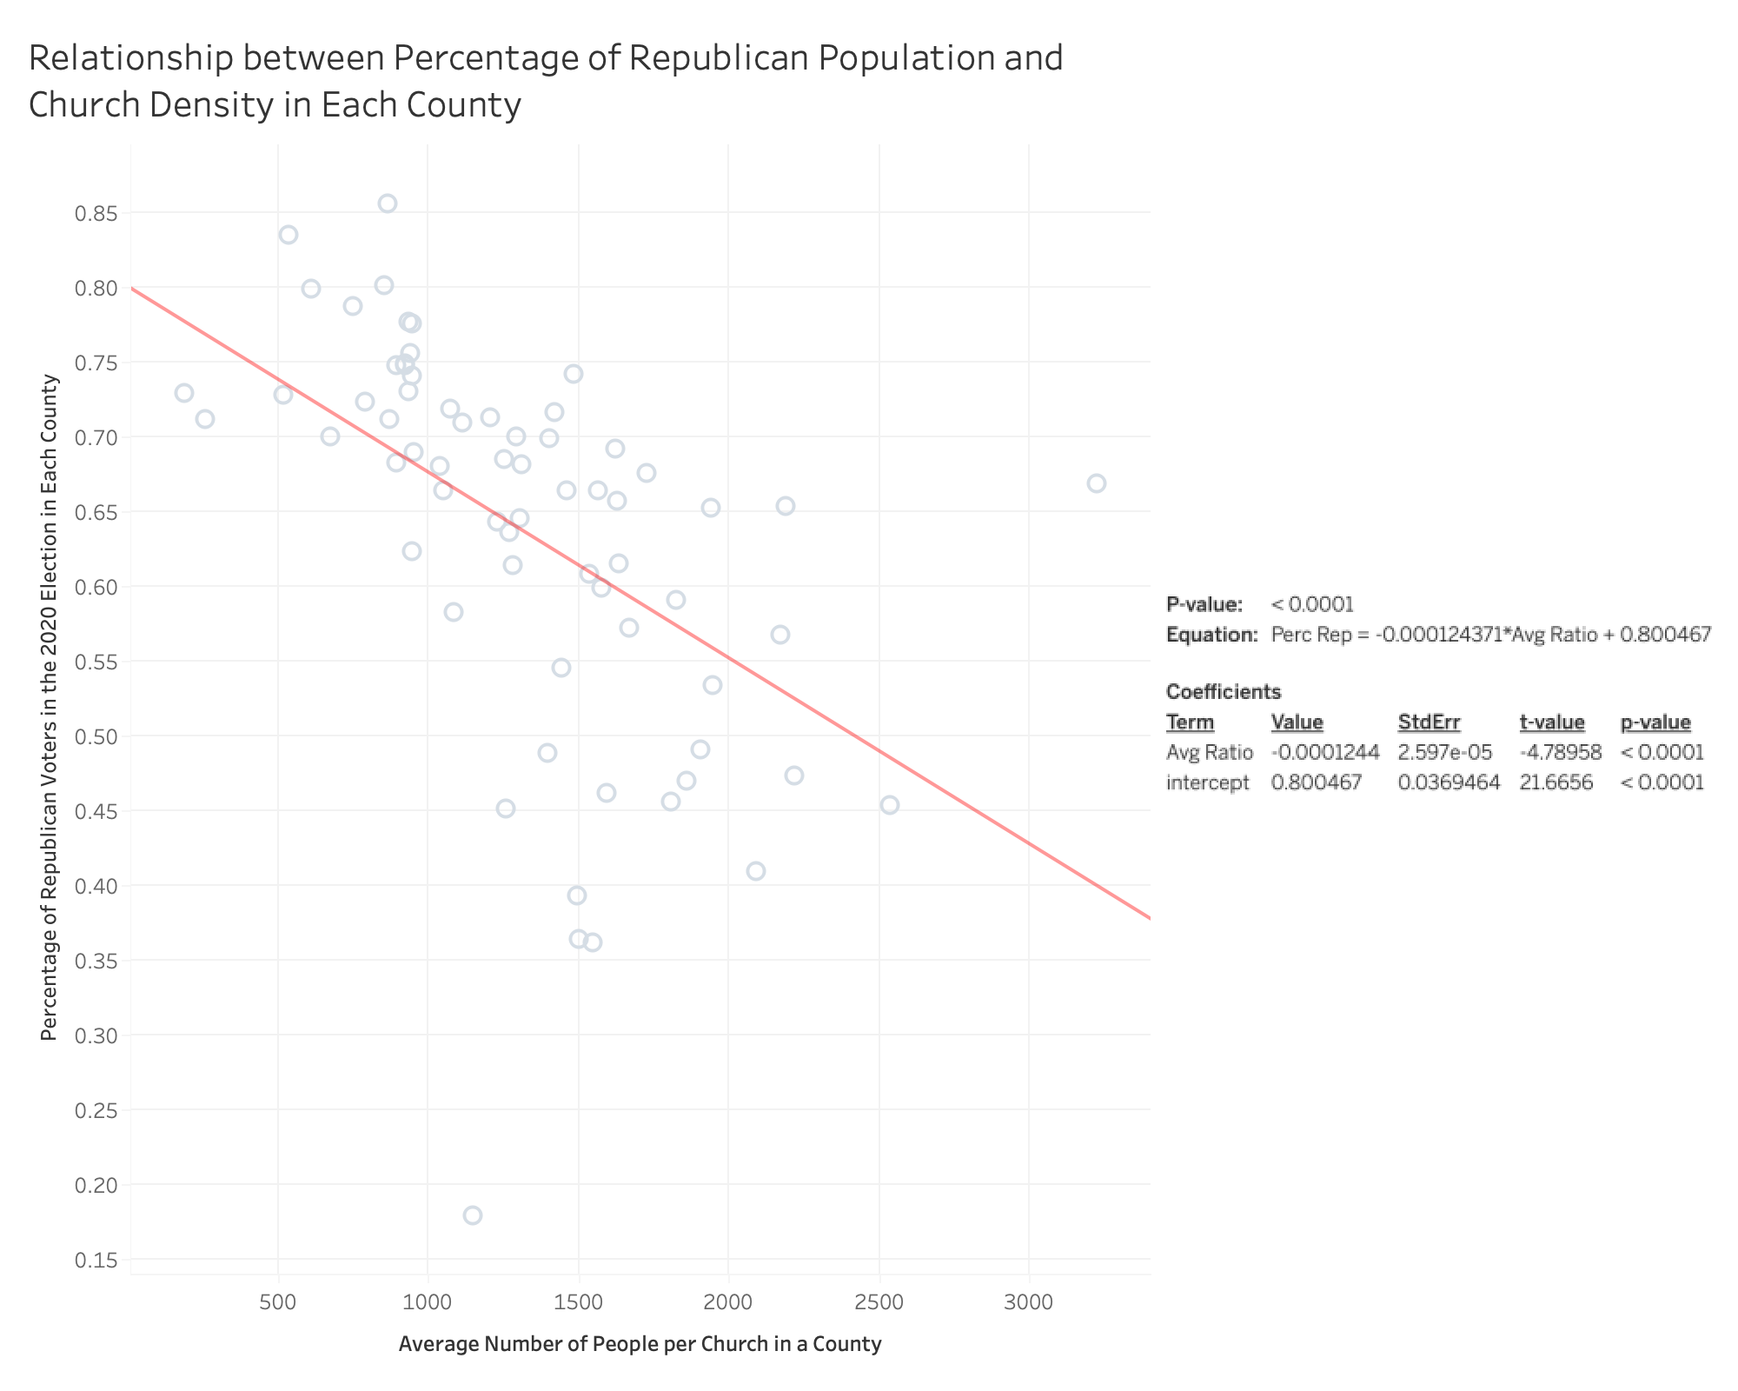
OLS REGRESSION

Slide 11
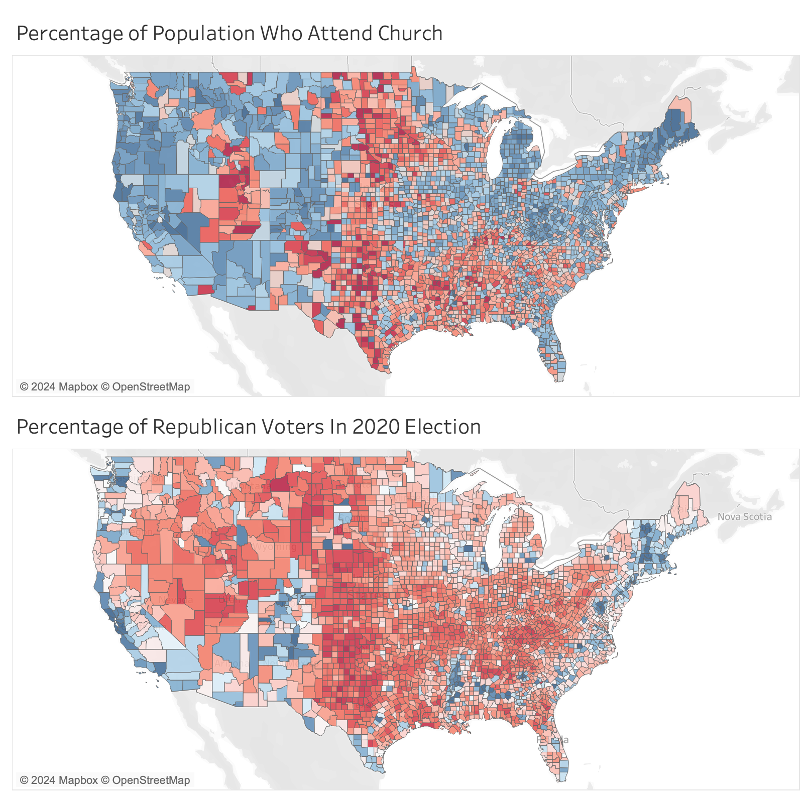
Exploratory Data Analysis: US Religion Census

Slide 12
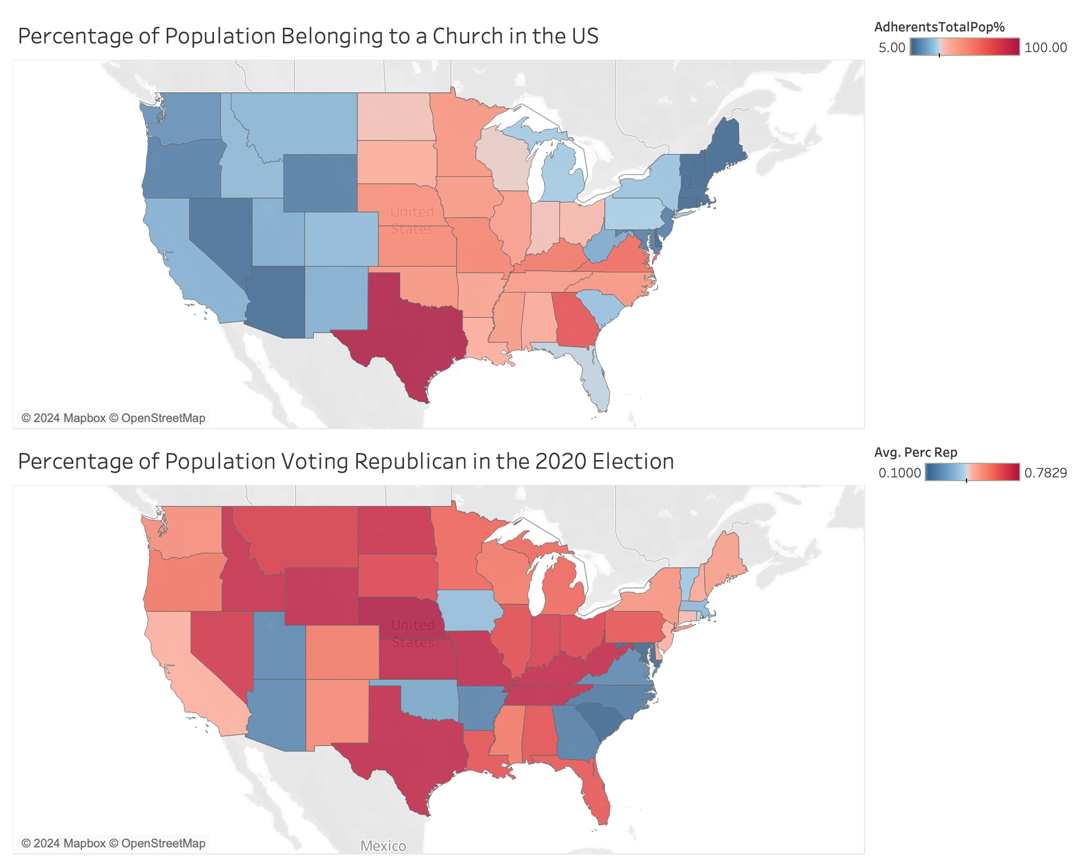

Slide 13
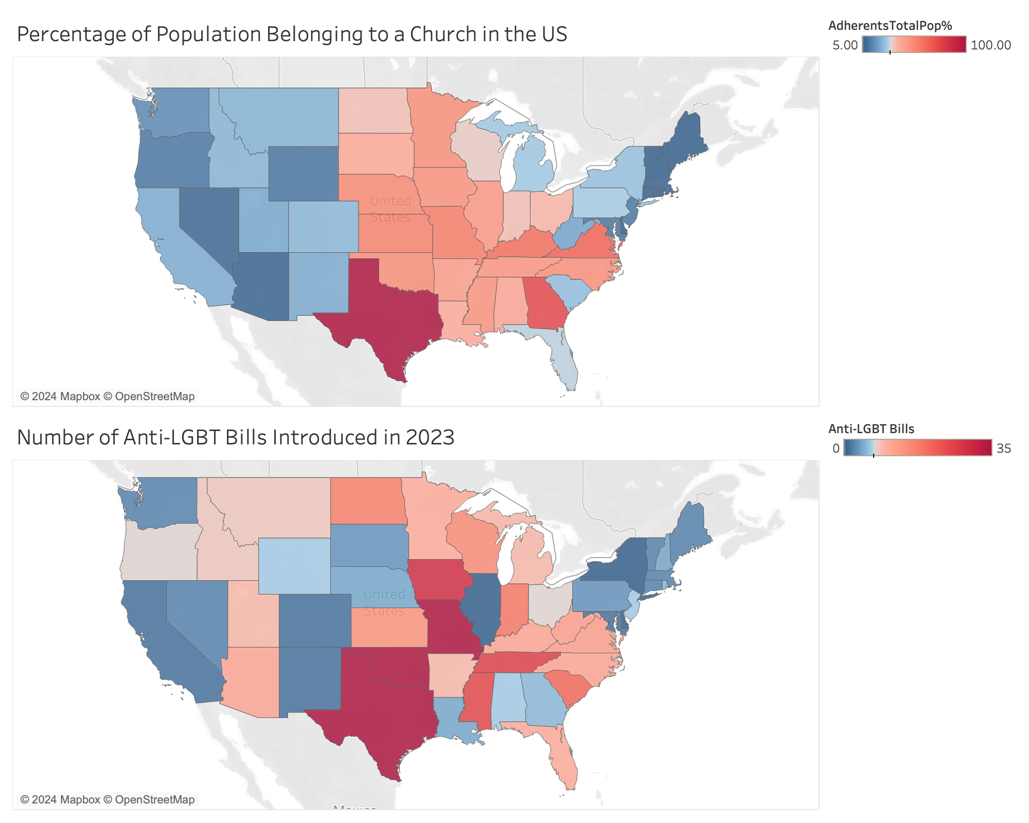

Slide 14
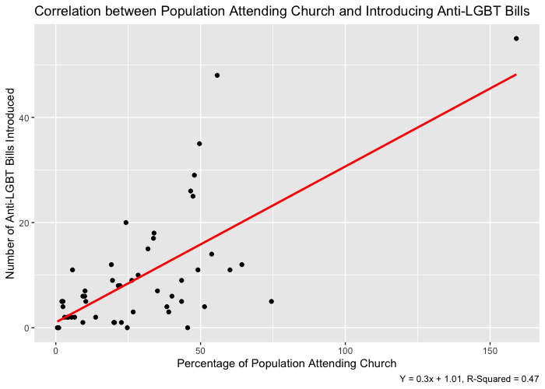
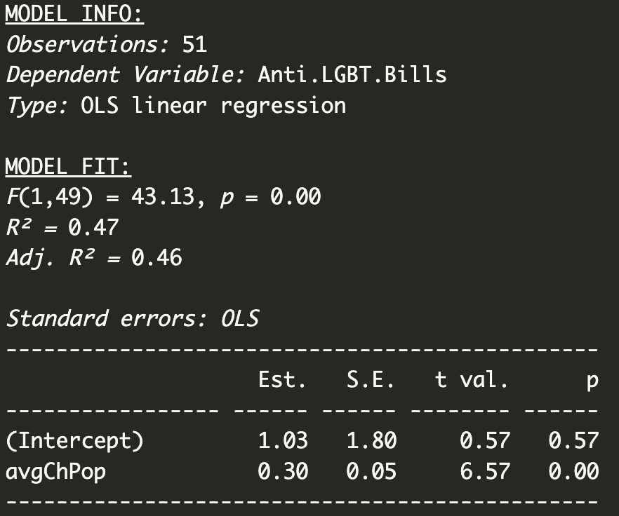
OLS Regression

Slide 15
Stakeholders & Implications
Religious Institutions: A correlation between certain religious beliefs and support for anti-LGBT legislation might lead to increased scrutiny and potential reputational damage.
Political Leaders and Policymakers: Understanding the religious influence on voting patterns can help policymakers make more informed decisions regarding anti-LGBT legislation. They may need to balance one’s beliefs with the principles of equality and human rights.
LGBTQ+ Advocacy Groups: Findings could guide advocacy groups in strategizing and targeting their efforts. If there is a strong religious correlation with anti-LGBT sentiment, these groups may need to focus on outreach and education within religious communities.
Community Members/Voters: Raise public consciousness about the connection between religion, voting choices, and social issues. It could also encourage open dialogues within the community about diversity and acceptance.
Media and Public Perception: The media's interpretation and reporting of the study can influence public perception. It's crucial for the media to present the findings accurately and avoid perpetuating stereotypes or stigmatizing any group.
Legal and Human Rights Organizations: If the study reveals a connection between religious beliefs and discriminatory legislation, it may prompt legal and human rights organizations to challenge such laws on constitutional or human rights grounds.

